Slide 1
Diffusion Models for Images & Videos

Slide 2
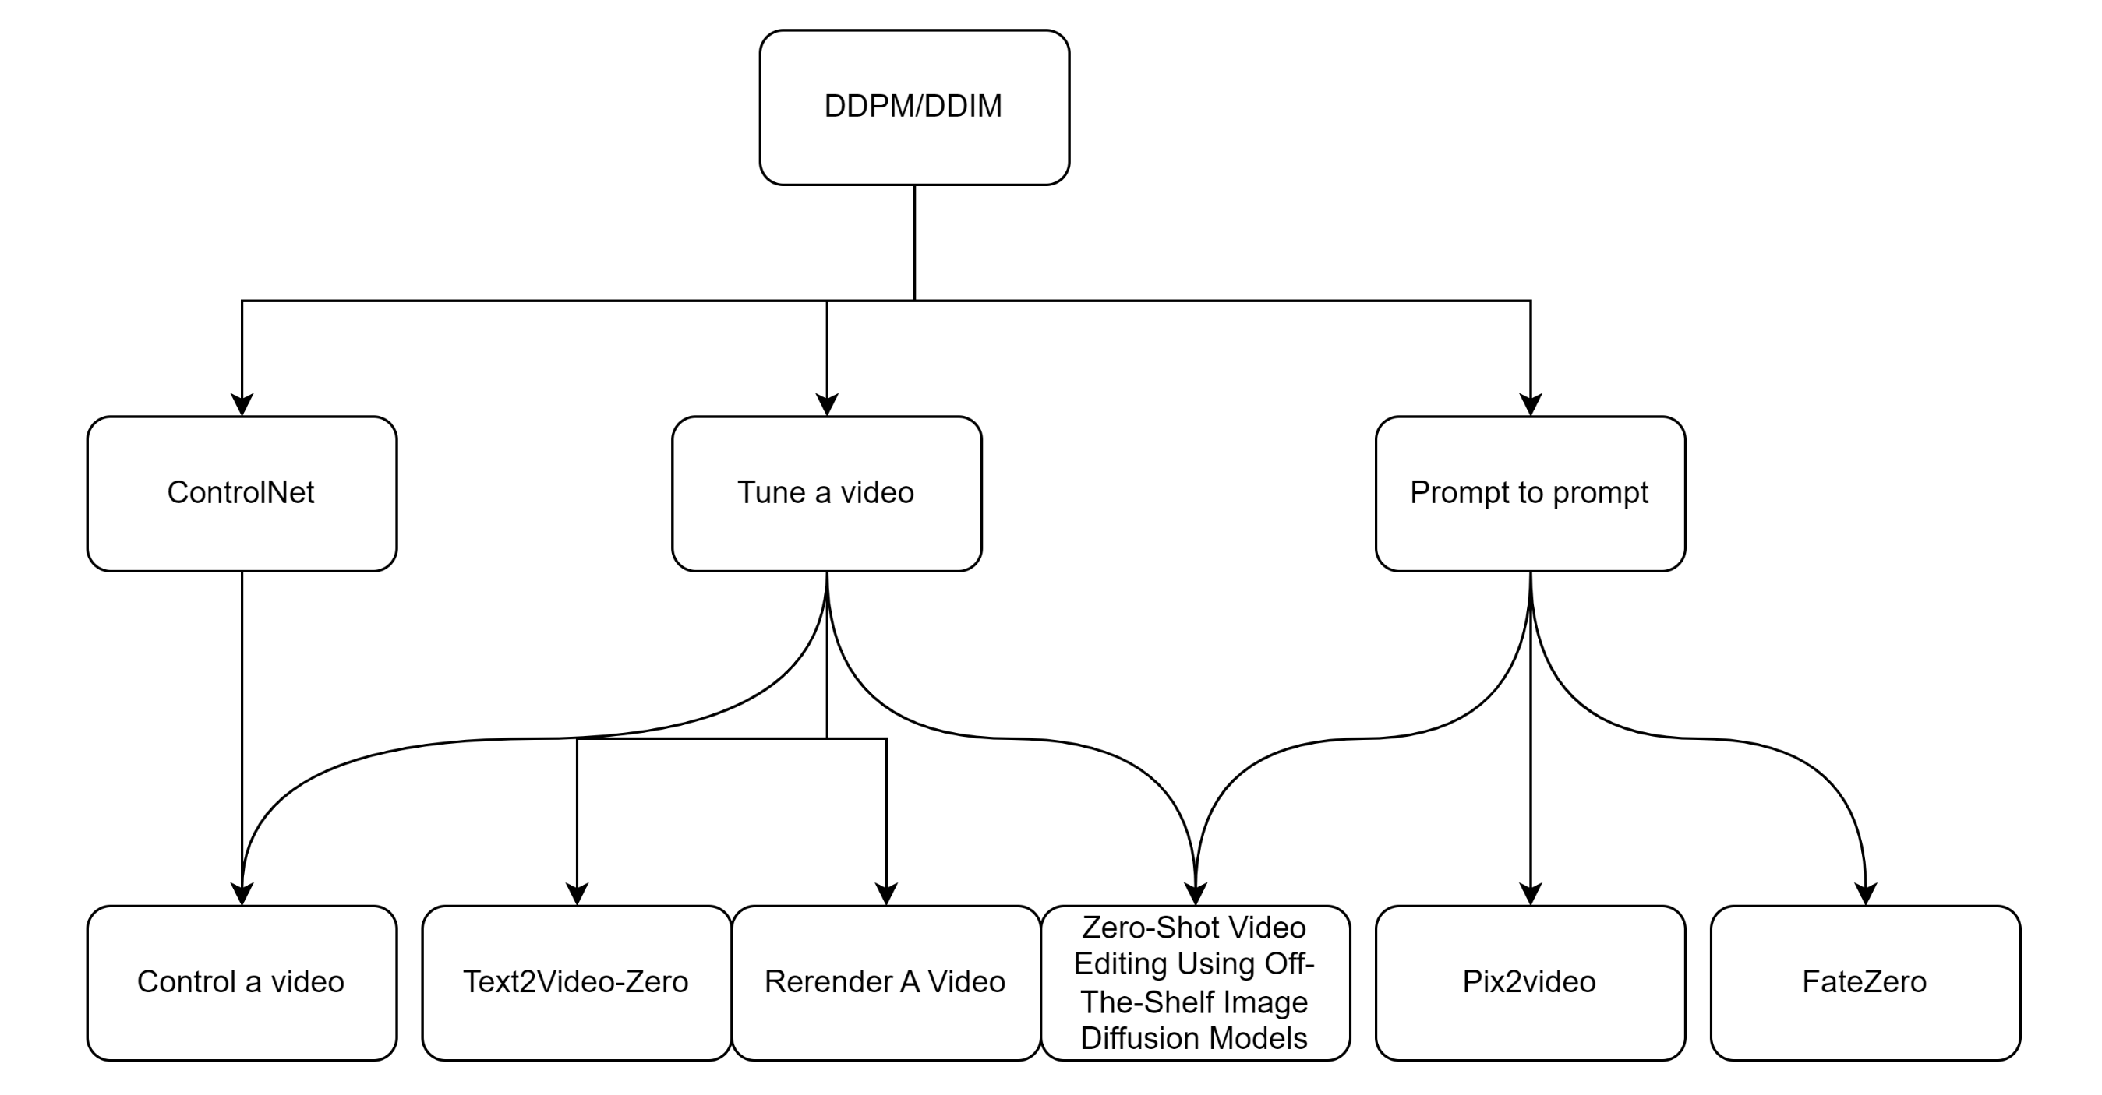

Slide 3
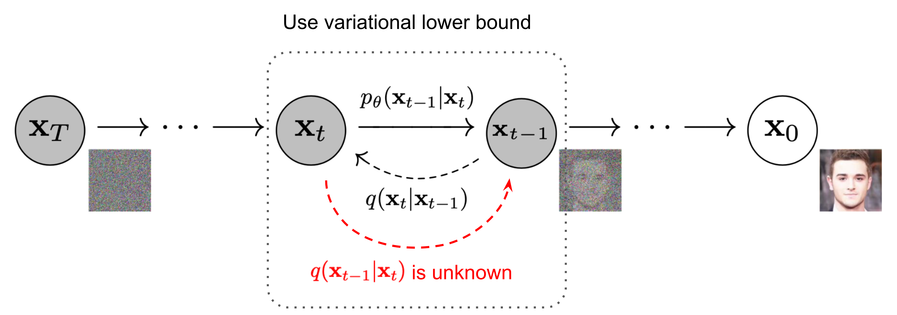
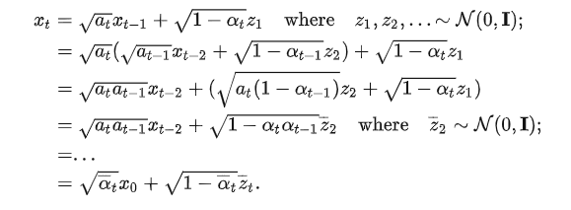
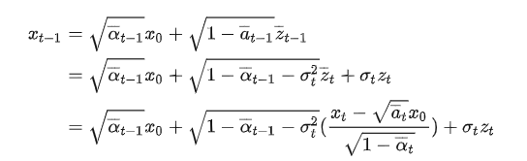
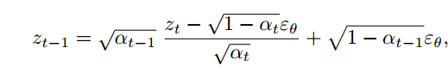
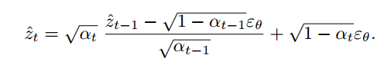
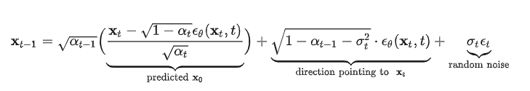
DDPM/DDIM
DDPM:
DDIM:
Sampling:
Inversion:

Slide 4
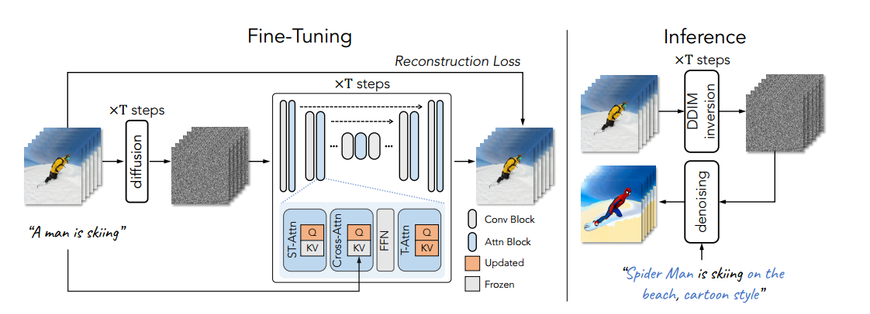
Tune a video

Slide 5
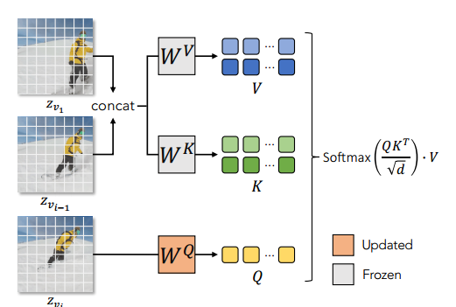
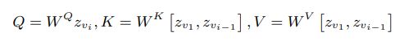
Tune a video
Regarding motion : T2I models are able to generate images that align well with the text, including the verb terms.
Regarding consistent objects : Simply extending the spatial self-attention in the T2I model from one image to multiple images produces consistent content across frames

Slide 6
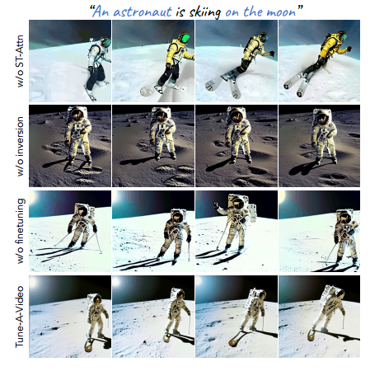
ST-Attn : 维持前后景的一致性
Inversion : 维持输入视频的动作
Finetuning :优化运动的流畅程度
Notes:
消融实验

Slide 7
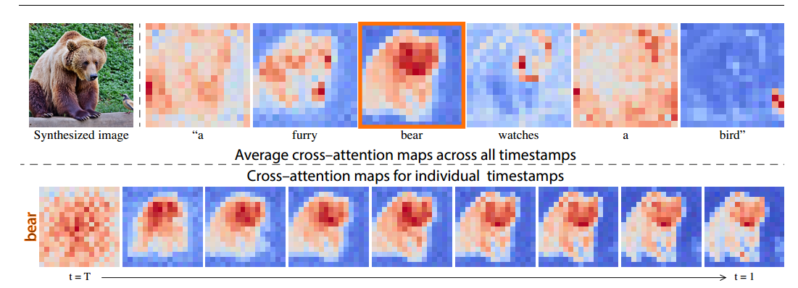
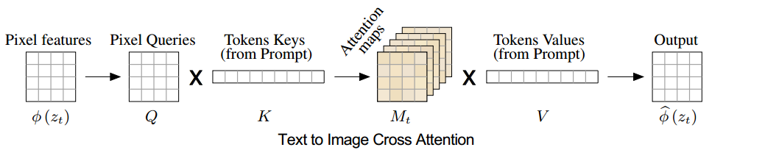
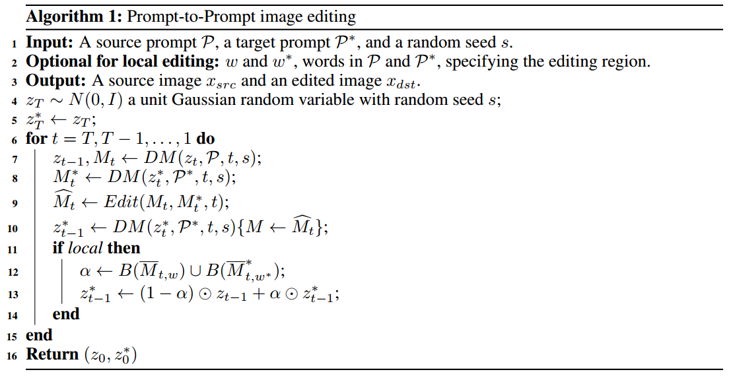
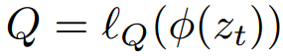
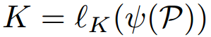
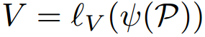
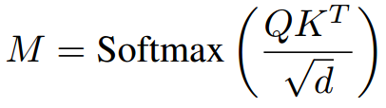
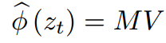
Prompt to prompt
the spatial layout and geometry of the generated image depend on the cross-attention maps

Slide 8
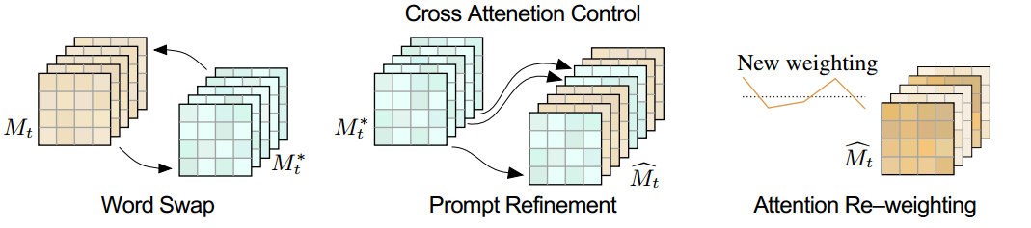
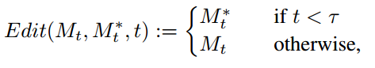
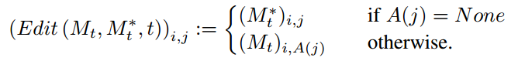
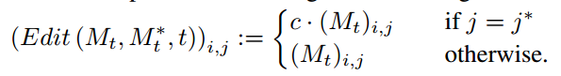
Prompt to prompt
Word Swap
Prompt Refinement
Attention Re-weighting

Slide 9
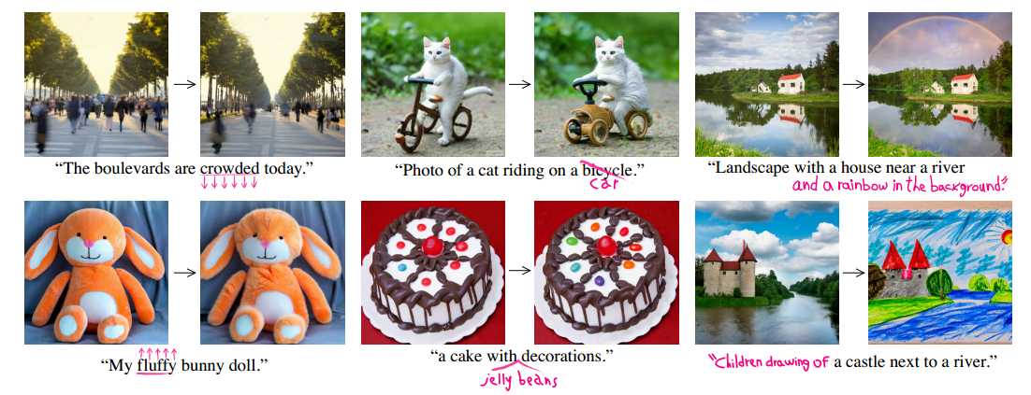
Prompt to prompt

Slide 10
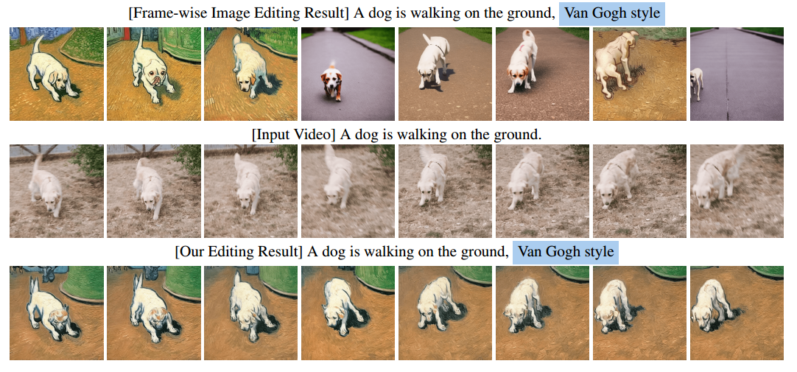
Zero-Shot Video Editing
Comparison
Tune-A-Video：zero shot
Image Editing：temporally-consistent results

Slide 11
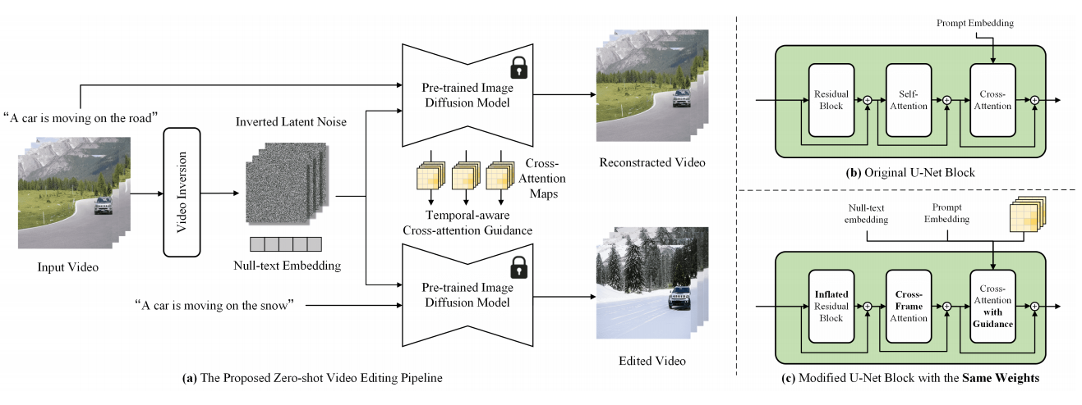
Zero-Shot Video Editing

Slide 12
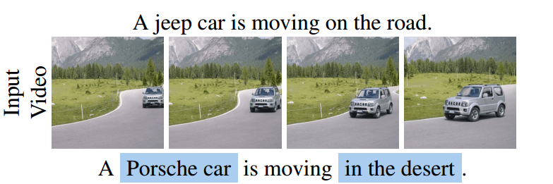
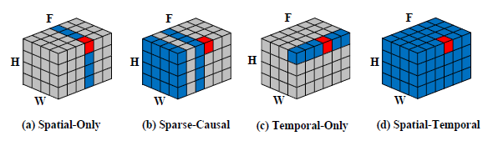
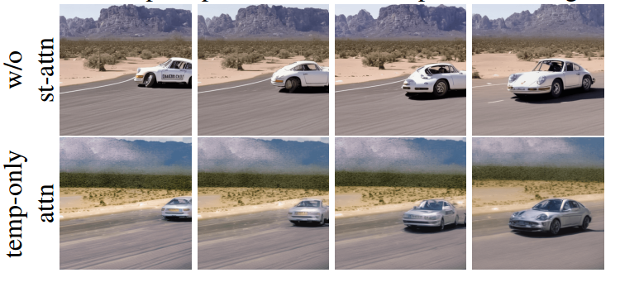
Zero-Shot Video Editing
(b) Tune-A-Video: over-emphasizes the previous frames of the video, and the editing errors in the first few video frames propagate to the subsequent frames
(c) completely abandons spatial modeling, leading to a significant discrepancy with the self-attention in pre-trained image diffusion models
(d) bi-directional temporal modeling

Slide 13
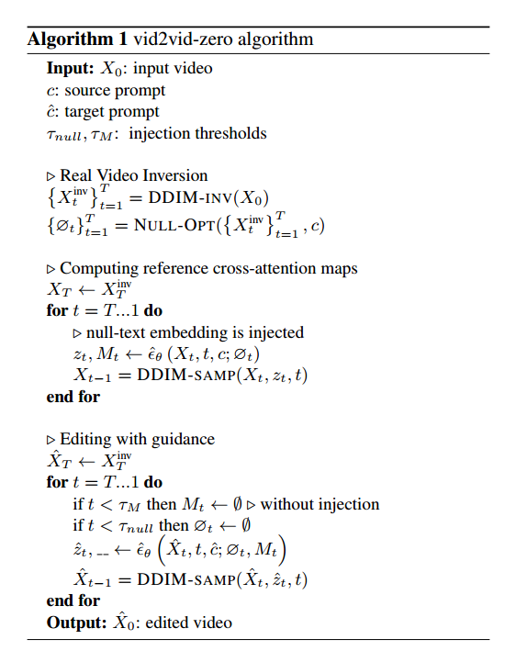
Zero-Shot Video Editing
Null text Optimization
Temporal Modeling
Spatial Regularization

Slide 14
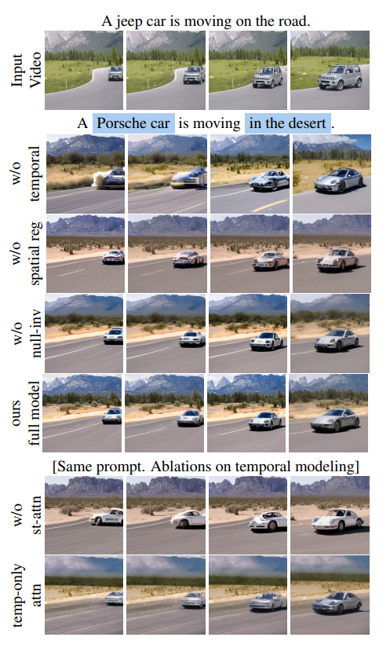
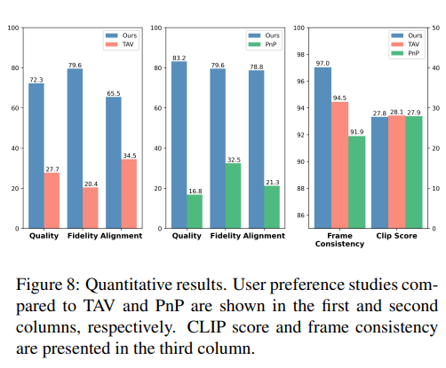
Zero-Shot Video Editing
Experiments
CLIP score: computes the similarity between the target prompt and the edited videos
Frame consistency: cosine feature similarity of consecutive frame pairs, based on their CLIP embedding

Slide 15
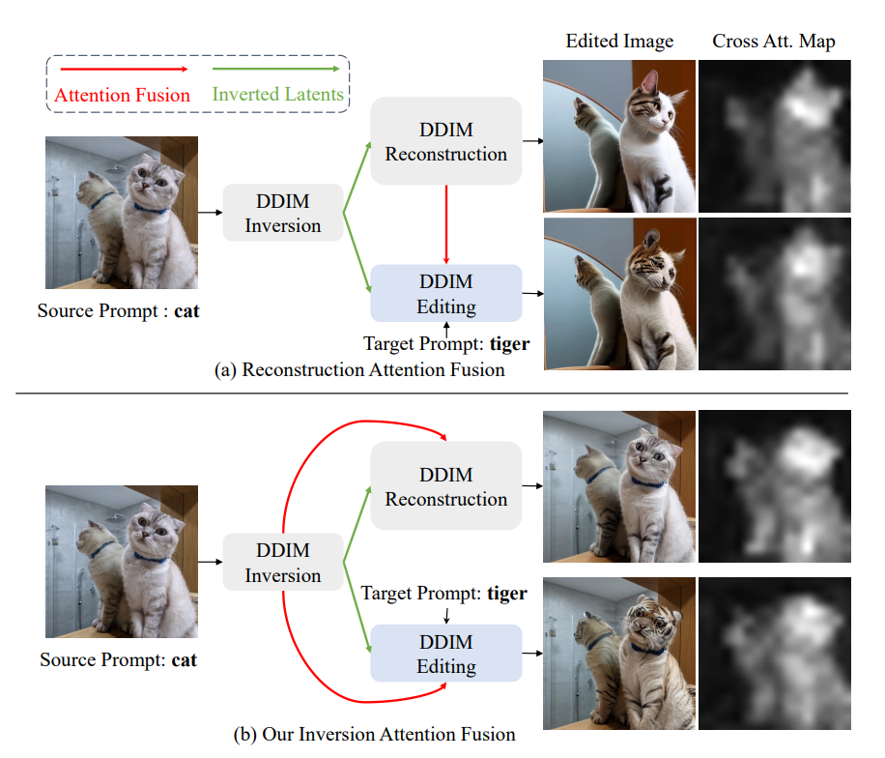
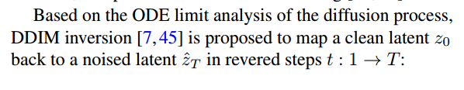
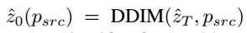
FateZero
DDIM Sampling:
DDIM Inversion:

Slide 16
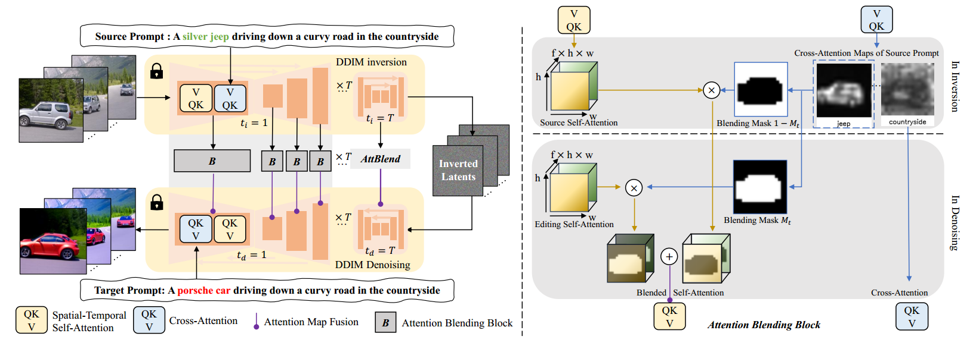
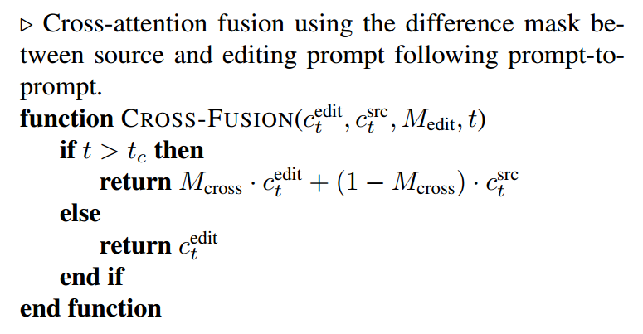
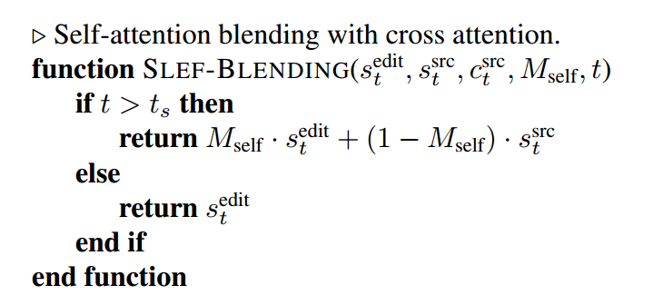
FateZero
Notes:
cross-attention is fused based on a mask of the edited words,
and the self-attention is blended using a binary mask from
thresholding the cross-attention

Slide 17
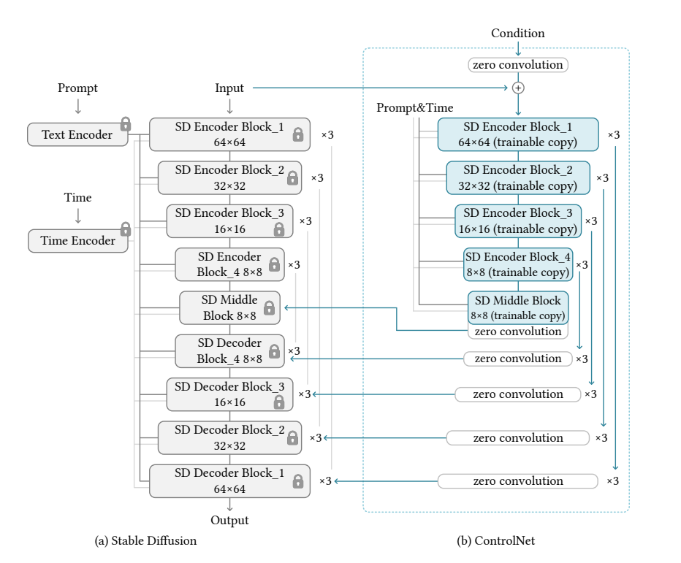
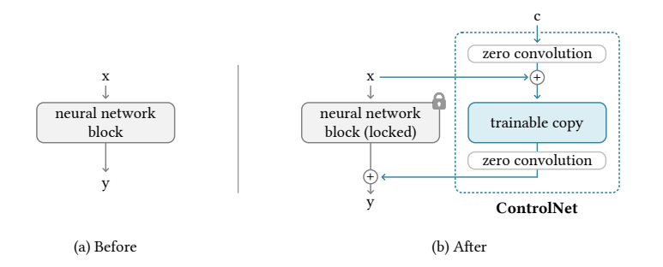
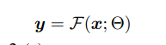
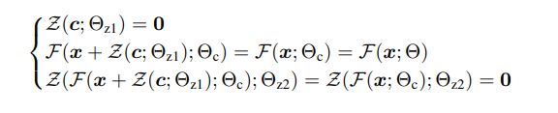
ControlNet
First step

Slide 18
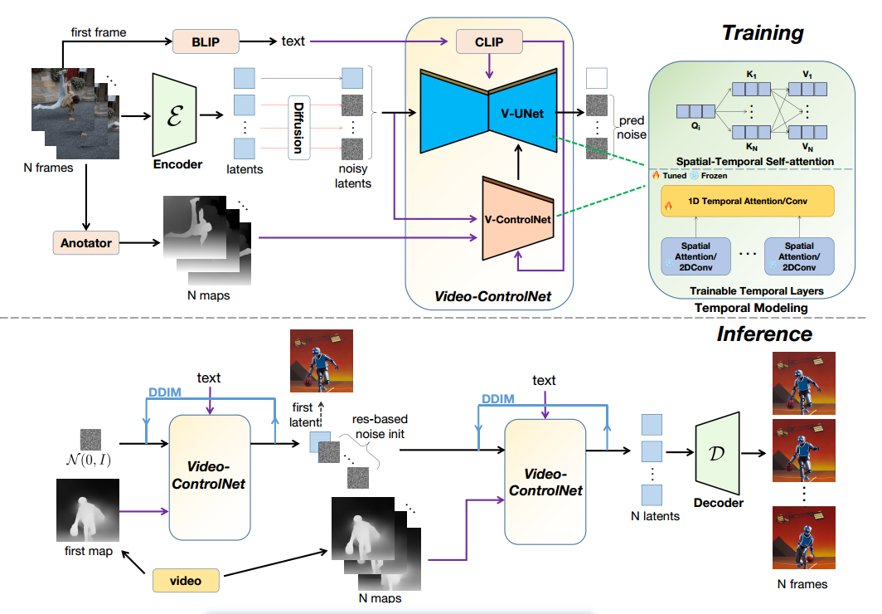
Control a video

Slide 19
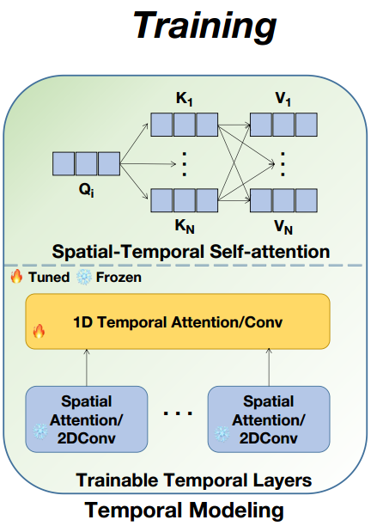
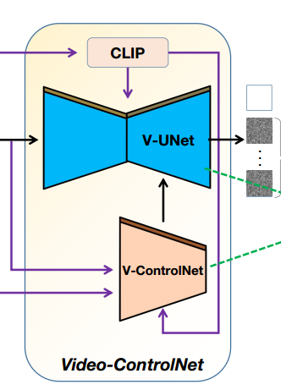
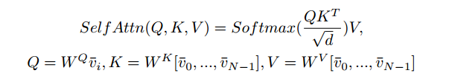
Control a video
an additional temporal layer after each 2-dimensional (2D) layer,including 2D convolution and 2D attention
modify the 2D spatial self-attention layer to incorporate temporal information
V-ControlNet

Slide 20
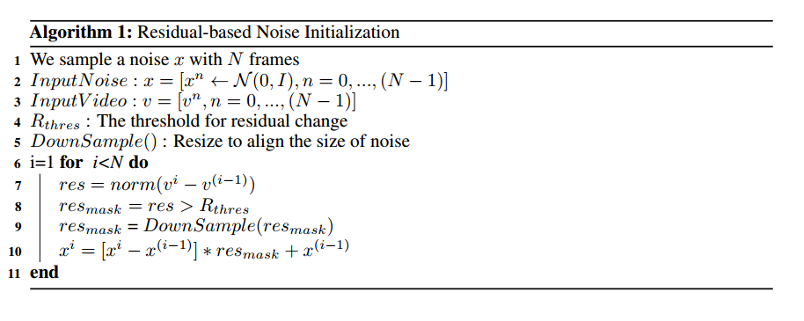
Control a video
Residual-Based Noise Initialization
In video compression, it is typical to store keyframes along with residuals/motion, instead of individual pixels for each frame.
Goal :maintain the same noise in areas where the pixels of the input video remain unchanged between frames and use different noise in areas where the pixels of the input video change between frames.
Notes:
首先，为每一帧随机初始化一个噪声，然后计算相邻帧像素上的差值
静态区域拥有相同的噪声，动态区域是不同的噪声；通过设定阈值来调节平滑度
如果阈值设置为1，则所有帧的噪声都是相同的，这可能会导致伪影。如果阈值设置为零，则每帧的噪声都是独立采样的，这可能会导致闪烁。

Slide 21
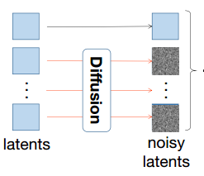
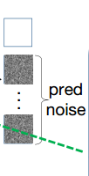
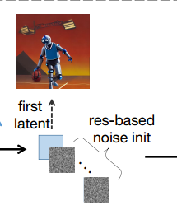



Control a video
Training & Inference
proposed a first-frame conditioning method
generates video sequences conditioned on the first frame
reduces the need for the model to memorize video content in the training set
focuses on learning to reconstruct motion
achieve better results with a smaller video dataset
Generate first frame:
Generate following frame:

Slide 22


Control a video
Experiments
Backbone: Stable Diffusion v1.5;
ControlNet
Dataset: 100k video clips
& 100k image-text pairs

Slide 23

Control a video
Ablation Study
distinct noise (threshold=0.0):background flickers
identical noise (threshold=1.0) : a smooth video, but with severe artifacts

Slide 24

Text2video-zero

Slide 25


Text2video-zero
Notes:
introduce motion dynamics

Slide 26




Text2video-zero

Slide 27

Text2video-zero
better text-video alignment
Experiments
CogVideo

Slide 28

Text2video-zero
Experiments

Slide 29

Text2video-zero
Ablation Study

Slide 30



Pixel2video
DDIM Inversion
Self-attention Feature Injection
Guided Latent Update
Notes:
While the cross-attention blocks are effective in terms of achieving faithfulness to the text prompt,
self-attention layers are effective in determining the overall structure and the appearance of the image

Slide 31



Pixel2video
Guided Latent Update（ only for first 25 steps ）
${\hat{x}}_{0}^{t}是一个$关于$x_{t}$的式子，表示第t步时对$x_{0}$的预测

Slide 32




Pixel2video
Comparison
User Study
Quantitative comparison
Notes:
does not require a heavy pre-processing stage nor a per-video or per-edit finetuning strategy.

Slide 33

Pixel2video
Ablation Study
a fixed anchor frame: structural artifacts as the distance between the anchor and the edited frame increases
the previous frame only: temporal and structural artifacts
an anchor frame and a randomly selected previous frame: temporal and structural artifacts
an anchor frame and a previous frame
previous frame: represents the state of the edit in a recurrent manner
anchor frame: temporal consistency

Slide 34

Rerender a video
Style-aware cross-frame attention
Shape-aware cross-frame latent fusion
Pixel-aware cross-frame latent fusion
Color-aware adaptive latent adjustment

Slide 35




Rerender a video
Style-aware cross-frame attention
Shape-aware cross-frame latent fusion
$ω_{j}^{i}$ optical flow
$M_{j}^{i}$ occlusion mask

Slide 36








Rerender a video
Pixel-aware cross-frame latent fusion
Structure-guided inpainting
Fidelity-oriented image encoding
$${\tilde{I}}_{i}^{′}=$$
observation : the amount of information lost each time
in the iterative auto-encoding process is consistent

Slide 37



Rerender a video
Comparison

Slide 38

https://anonymous-31415926.github.io/

Slide 39

Rerender a video
Ablation Study

Slide 42
Rerender a video
Color-aware adaptive latent adjustment
在靠后的时间步，使用AdaIN匹配第一帧和第i帧的${\hat{x}}_{t}$
Full Video Translation
Color-aware adaptive latent adjustment
Full Video Translation
Patch-based propagation
Temporal-aware blending
（TODO）
Notes:
y AdaIN [15] to xˆit→0to match its channel wise mean and variance to xˆ1t→0in the late steps. It can further keep the color style coherent throughout the whole key frames

